Slide 1
Margin Trading

Slide 2
Margin Trading
Investors sometimes borrow money to buy stocks. They loan part of the proceeds and keep the stock as collateral.
The margin in the account is the portion of the purchase price contributed by the investor. Or collateral that the investor has to deposit.
The percentage margin is:
Margin = Equity in account / Value of account (stock)
Assets | Liabilities and Owners’ equity
Value of stock $10,000 | Loan from broker $6,000
 | Equity $4,000

Slide 3
Margin Trading – cont’d
An investor must pay interest on a margin loan, until the debt is repaid from the eventual sale of the securities.
The base rate for these loans is called the broker’s call money rate.
The smaller the loan, the higher the interest rate.

Slide 4
Margin Trading – cont’d
Initial margin: the minimum percentage equity an investor must have in a new position.
In U.S investors now must put up at least 50 percent. Alternately, borrowing in a new position may not exceed 50 percent.
In HK, 30-60%.
Maintenance margin: the minimum percentage equity an investor must have in his account at all times afterwards. Currently at least 25 percent in U.S.
Margin call: a requirement to deposit additional equity into a brokerage account because the account equity fell below the maintenance margin limit.

Slide 5
Margin Trading – cont’d
Example: Calculate the price that triggers a margin call.
Assume you buy 200 shares at $40 a share (ignore interest payment for now).
IM (initial margin) = 50%
MM (maintenance margin)= 30%
Loan = 0.50×200×40 = $4,000.
Later on, it must always be that
Margin = (Value of account − Loan) / Value of account
= (200P−4,000)/(200P) ≥ 0.30
Margin call will occur when
(200P−4,000)/(200P) = 0.30, or, P = $28.57.

Slide 6
Margin Trading – cont’d
Suppose one fine afternoon, not long afterwards, the price drops to $26. How much will the investor have to put up when his broker calls (Assume the broker requires investors to bring the margin back to the IM level)?
Value of account at lower share price
= $26×200 = $5,200
Maximum borrowing (under the IM requirement)
= $0.50×5,200 = $2,600
Previous borrowing
= $4,000
Additional money required
= $(4,000−2,600)=$1,400

Slide 7
Margin Trading – cont’d
If the investor cannot come up with the additional equity, then he must liquidate some of the account. Suppose he sells N shares at the lower price of $26 and surrenders proceeds to the broker in order to bring his equity back up to 50 percent. Then,
Value of remaining position
= 26×(200−N) = 5,200−26N
Remaining borrowing
= 4,000−26Ν
4,000−26N = 0.5×(5200−26Ν)
N = 108.

Slide 8
Example
You purchased 100 shares of common stock on margin at $40 per share. Assume the initial margin is 50% and the stock pays no dividend. What would the maintenance margin be if a margin call is made at a stock price of $25?
A. 0.33
B. 0.55
C. 0.20
D. 0.23
E. 0.25

Slide 9
Margin Trading - contd
So far we were bearish on the stock price. Now suppose that price rises to $50. Then his equity rises to 60 percent. Confident that the winning streak will continue, investor uses his increased equity to buy an additional N shares. How large can N be?
Value of increased account
= 50×(200+N) = 10,000+50N
Value of increased borrowing
= 4000+50N
4,000+50N = 0.5×(10,000+50N) or,
N = 1,000/25 = 40 shares.
He owns 240 shares worth $12,000 and has borrowed $6,000.

Slide 10
Exercise
You purchased 100 shares of common stock on margin for $35 per share. The initial margin is 50% and the stock pays no dividend. What would your rate of return be if you sell the stock at $42 per share? Ignore interest on margin.
A. 28%
B. 33%
C. 14%
D. 40%
E. 24%

Slide 11
Margin Trading – cont’d
So far we ignored the interest payment on borrowing. If the margin account is carried for a substantial length of time, interest payment can be substantial.
Suppose investor buys 100 shares for $40 and uses 50 percent margin (= $2,000). One year later, the stock price rises to $50. Assume a broker call money rate of 5 percent.
Return when there is no borrowing
= Profit / Investment = 1,000/4,000 = 25 percent
Return with 50 percent borrowing
= (1,000−0.05×2,000)/2,000 = 45 percent

Slide 12
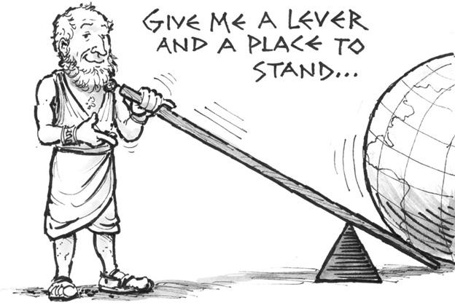
Margin Trading - contd
Suppose price instead falls to $30. Then,
Return when there is no borrowing
= −1,000/4,000 = −25 percent
Return with 50 percent borrowing
= (−1,000−0.05×2,000)/2,000 = −55 percent
Lesson for investors: Borrowing increases both upside and downside returns.

Slide 13
Margin Trading – cont’d
Assume the margin requirement is only 10 percent. Suppose an investor buys 200 shares for $40. He puts up $0.10×200×40 = $800. Price increases to $48. His equity increases by $200×8 = $1,600.
How many more shares can he buy now?
(1,600 × 9 )/ 48 = 300. So he now owns 500 shares worth $24,000!
The price increase can have a pyramidal effect. Price increase implies increased margin to buy even more. And buying more shares implies that prices increase still further!

Slide 14
Margin Trading - contd
May be economic conditions do not look ecstatic. Realizing that $48 is too high a price, some investors begin selling. The price goes down to $42. What’s investor’s equity now?
Loan: $0.90×200×40 + $1,600×9 = $21,600
Value of account: $42×(200+300) = $21,000
Equity = -$600
Lesson for brokers and industry: The margin requirements should be higher.

Slide 15
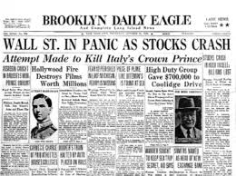
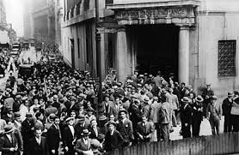
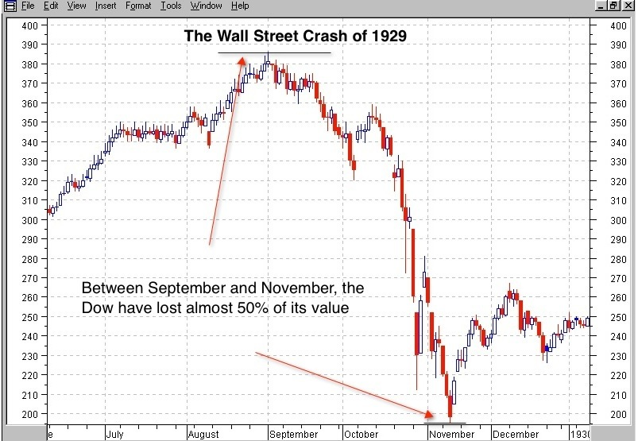
Wall Street Crash of 1929

Slide 16
Quick Review
Margin trading
Margin buying
Initial margin, maintenance margin and margin call
Borrowing increases both upside and downside returns.
Margin = Equity/ Value of stocks

Slide 17
Short Selling
Short sales are sales of securities you don’t own but have borrowed from your broker with a commitment to buy it back later to cover your position
Bet on a decline in the price of the security
The proceeds from the short sale must be maintained with the broker as collateral
Short-seller must pay any dividends paid during the short sale to the lender of the stock

Slide 18
Short Sales - Margin Call
Margin on short position works differently. Suppose an investor shorts 100 shares at $40 a share. The entire $4,000 is kept in an escrow account with the broker. In addition, the investor puts up a good faith margin/equity deposit of 50 percent (= $2,000). Suppose maintenance margin is 30 percent. At what price P will the investor get margin call? Ignore interest payments.
Margin = Equity/ Value of shorted stocks (Liability)

Slide 19
Short Sales – Margin Call
Liability to the broker/lender of stock
= 100P
Value of the account
= $6,000
Equity in account
= 6,000−100P, which must not fall below 30 percent of liability to broker. ← The margin is calculated based on the market value of the short.
6,000−100P = 0.30×100P, or, P = 6,000/130 = $46.15.
Thus expect a margin call when price rises above $46.15.
Remember a short position gains equity from falling stock prices and loses equity from rising stock prices!

Slide 20
Exercise
Assume you sell short 100 shares of common stock at $30 per share, with initial margin at 50%. What would be your rate of return if you repurchase the stock at $35/share?

Slide 21
More Exercise
You purchase 300 shares of Square Enix at $40 per share. To pay the purchase, you borrow $4,000 from your broker.
What is the percentage margin in your account when you first purchase the stock?
equity = 40×300 - 4,000 = 8,000
percentage margin = 8,000/ (40×300) =66.67%
If the share price falls to $30 per share by the end of the year, what is the remaining percentage margin in your account? If the maintenance requirement is 30%, will you receive a margin call?
percentage martin = (30×300-4,000)/(30×300)=55.56% > 30%. Won’t receive a margin call.

Slide 22
More Exercise
You purchase 300 shares of Square Enix at $40 per share. To pay the purchase, you borrow $4,000 from your broker.
If the interest rate on the loan over the borrowing period is 5%,what is the rate of return on your account when you sell the stock at $30?
profit/loss = (30-40) ×300 - 5% ×4,000 = -3,200
rate of return = -3,200/8,000 = -40%

Slide 23
More Exercise
You just opened an account to short sell 500 shares of JNJ, at $92 per share. You broker’s initial margin requirement is 40%, and the maintenance margin requirement is 20%.
If the stock price goes down to $80, will you receive a margin call?
No. Since the price goes down, my equity value increased.
If the price rises to $108, will you receive a margin call?
equity=500 ×92 ×1.4 - 500 ×108 = 10,400
percentage margin = 10,400/(500 ×108)=19.26% < 20%. There will be a margin call.

Slide 24
More Exercise
You just opened an account to short sell 500 shares of JNJ, at $92 per share. You broker’s initial margin requirement is 40%, and the maintenance margin requirement is 20%.
Assume you buy stocks back at $108 to cover your position, what is the rate of return on the investment?
Rate of return = Profit (Loss)/Investment
= (92-108) ×500 / (92 ×500 ×0.4) = -43.48%

Slide 25
Review of Mathematics & Statistics

Slide 26
Mean
The arithmetic mean is the most commonly-used type of average and is often referred to simply as the average.
If the list is a statistical population, then the mean of that population is called a population mean, i.e. E[X] = μ
If the list is a statistical sample, we call the resulting statistic a sample mean.
The sample mean of a set of data denoted as X = (x1, x2, ..., xn) is given by

Slide 27
Median
In statistics, a median is described as the numeric value separating the higher half of a sample or population from the lower half.
The median of a finite list of numbers can be found by arranging all the observations from lowest value to highest value and picking the middle one.
Organize a group data in ascending order
1.05 , 1.89, 2.45, 2.45, 3.39, 3.39, 4.10
the median of this series is 2.45

Slide 28
Variance
In statistics, the variance of a random variable or distribution is the expected (mean) value of the square of the deviation of that variable from its expected value or mean.
Thus the variance is a measure of the amount of variation within the values of that variable, taking account of all possible values and their probabilities.
If a random variable X has the expected (mean) value E[X]=μ, then the variance of X can be given by:

Slide 29
Variance: Properties
Variance is non-negative because the squares are positive or zero.
The variance of a constant a is zero, and the variance of a variable in a data set is 0 if and only if all entries have the same value.
Variance is invariant with respect to changes in a location parameter. That is, if a constant is added to all values of the variable, the variance is unchanged.
If all values are scaled by a constant, the variance is scaled by the square of that constant.

Slide 30
Sample Variance
If we have a series of n measurements of a random variable X as X_{i}, where i = 1, 2, ..., n, then the sample variance, can be used to estimate the population variance of X = (x₁, x₂, ..., x_{n}), The sample variance is calculated as
The denominator, (n-1) is known as the degrees of freedom in calculating sample variance : Intuitively, once is known, only n-1 observation values are free to vary, one is predetermined by
When n = 1 the variance of a single sample is obviously zero regardless of the true variance. This bias needs to be corrected for when n is small.

Slide 31
Standard Deviation
In statistics, the standard deviation of a random variable or distribution is the square root of its variance.
If a random variable X has the expected value (mean) E[X]=μ, then the standard deviation of X can be given by:
That is, the standard deviation σ (sigma) is the square root of the average value of (X − μ)².
Sample standard deviation:

Slide 32
Covariance
The covariance between two real-valued random variables X and Y, with mean (expected values) and , is
Cov(X, Y) is one measure of how closely the values taken by two variables X and Y vary together. It can be negative, zero, or positive
Random variables with covariance is zero are called uncorrelated or independent

Slide 33
Covariance
If X and Y are real-valued random variables and a and b are constants ("constant" in this context means non-random), then the following facts are a consequence of the definition of covariance:

Slide 34
Variance of the Sum of Correlated Random Variables
If X and Y are real-valued random variables and a and b are constants ("constant" in this context means non-random), then the following facts are a consequence of the definition of variance and covariance:
The variance of a finite sum of uncorrelated random variables is equal to the sum of their variances.
This is because, if X and Y are uncorrelated, their covariance is 0.

Slide 35
Sample Covariance
If we have a series of n measurements of X and Y written as X_{i} and Y_{i} where i = 1, 2, ..., n, then the sample covariance can be used to estimate the population covariance between X=(X₁, X₂, …, X_{n}) and Y=(Y₁, Y₂, …, Y_{n}). The sample covariance is calculated as

Slide 36
Correlation Coefficient
A disadvantage of the covariance statistic is that its magnitude can not be easily interpreted, since it depends on the units in which we measure X and Y
The related and more used correlation coefficient remedies this disadvantage by standardizing the deviations from the mean:
The correlation coefficient is symmetric, that is
The value of correlation coefficient falls between −1 and 1:
ρ = 0 => X and Y are uncorrelated
ρ = 1 => X and Y are perfectly positively correlated
ρ = −1 => X and Y are perfectly negatively correlated

Slide 37
Scatter Plots of Data with Various Correlation Coefficients
Y
Y
Y
X
X
X
ρ = -1
ρ = -.6
ρ = 0
Y
Y
Y
X
X
X
ρ = +1
ρ = +.3
ρ = 0

Slide 38
Linear Correlation
Linear relationships
Curvilinear relationships
Y
Y
X
X
Y
Y
X
X

Slide 39
Linear Correlation
Strong relationships
Weak relationships
Y
Y
X
X
Y
Y
X
X

Slide 40
Linear Regression
In correlation, the two variables are treated as equals. In regression, one variable is considered independent (=predictor) variable (X) and the other the dependent (=outcome) variable Y.
What is “ Linear”: Y=α+βX?
A slope of 2 means that every 1-unit change in X yields a 2-unit change in Y.
β
α

Slide 41
Prediction
If you know something about X, this knowledge helps you predict something about Y.
y_{i}= α + β*x_{i} + random error_{i}
Follows a normal distribution
Fixed – exactly on the line

Slide 42
Resulting Formulas
Slope (beta coefficient) =
Intercept (alpha) =

